Slide 1

Sales data analysis – excel advanced project
Name : V Dhanasekaran
Date : 04/06/2025
Course & Batch : DA DS – APR 2025

Slide 2
PROJECT OVERVIEW & OBJECTIVES
OBJECTIVE :
To Analyze An Sales Dataset And Provide An Interactive And User Friendly Insights Using Dashboards , KPI’S, And Filters.
GOAL’S :
To Clean Dataset Using Data Validation, Remove Duplicates, If Error Function.
Analyze Sales Performance By The Product Categories.
To Using An Advanced Excel Features Like Macro’s, Goal seek , power pivot.
To Creating An Dashboard With Clear Insights With KPI’S

Slide 3
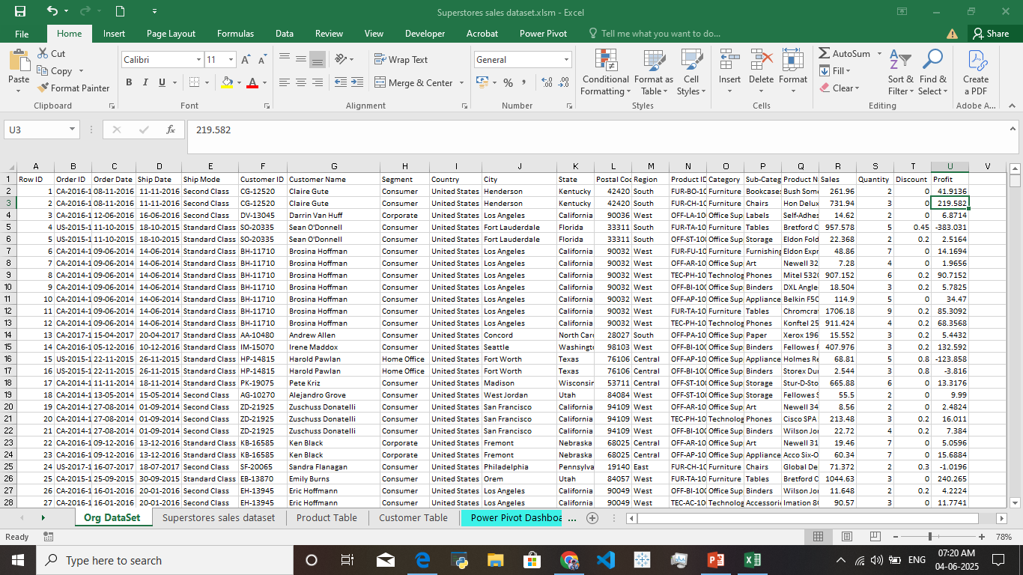
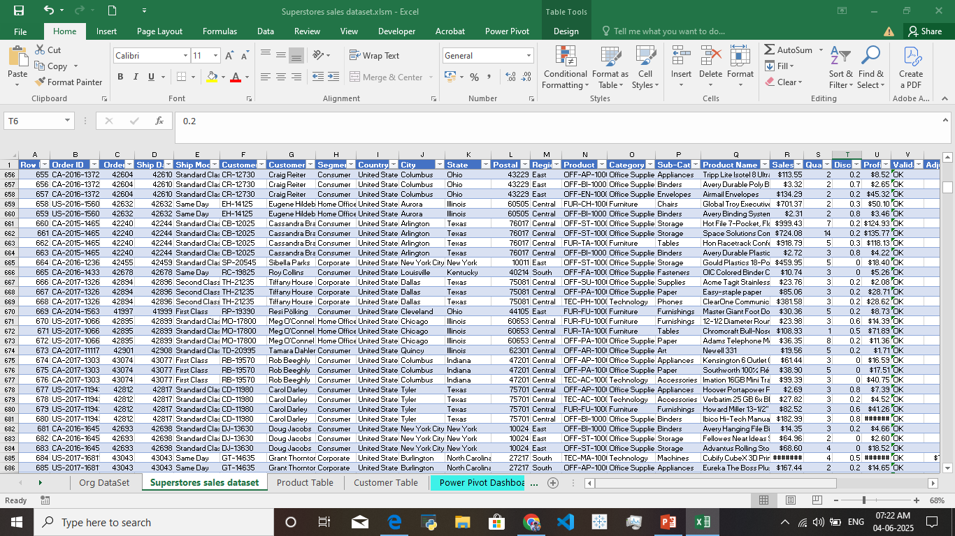
Data Description and Preparation
DATASET OVERVIEW :
The Superstore’s Sales Data with Details like Customer Id , Product Id ,Shipping Date , Shipping Categories, Discounts ,Profits and Customer Segments.
Data Cleaning Process :
To Remove Duplicates .
Use Data Validation To the Data Values Are Valid.
Use Format To the Relavent Columns To Change The Data Types.
Before :
After :

Slide 4
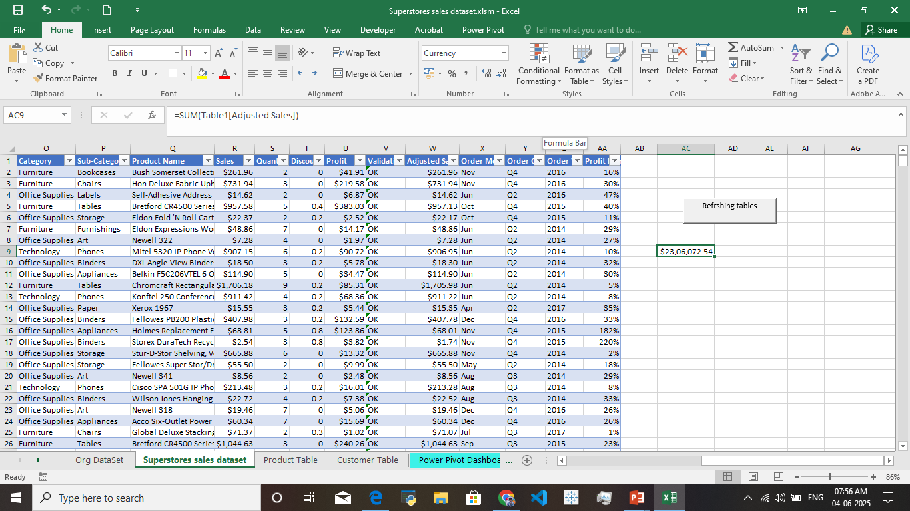
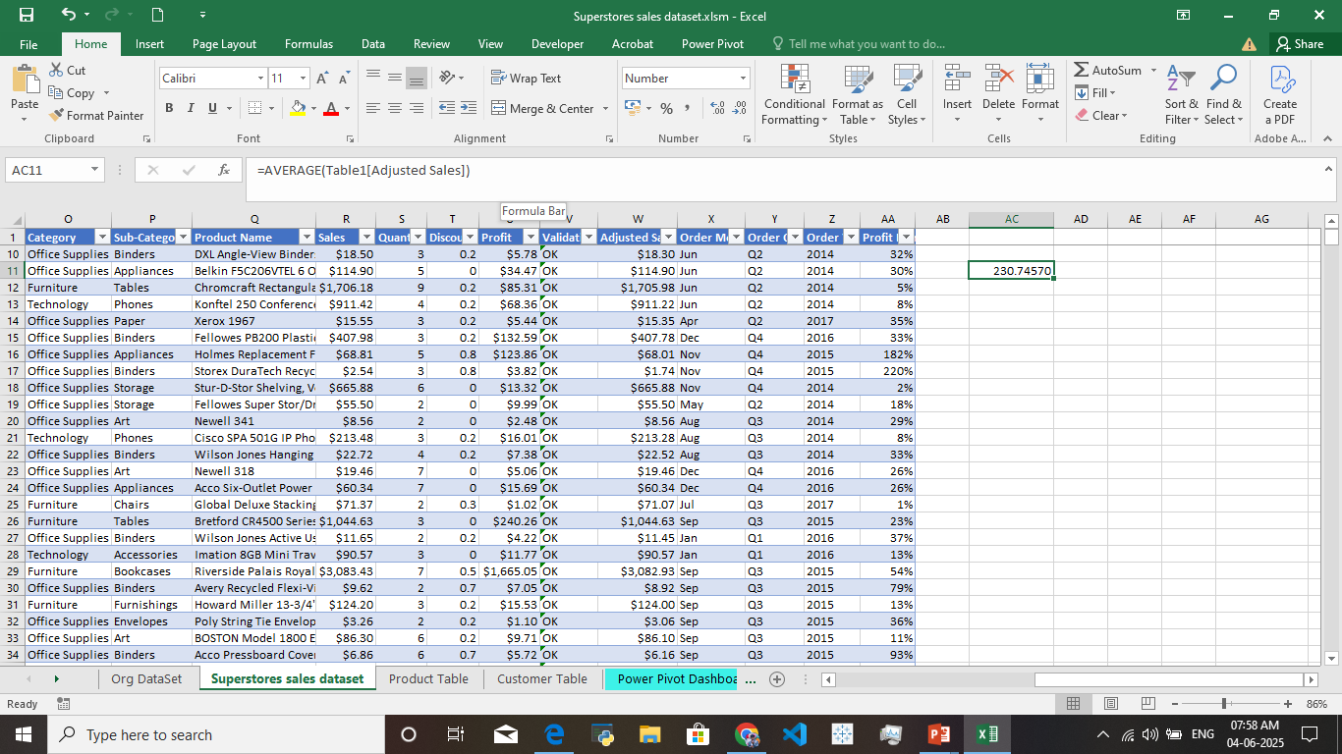
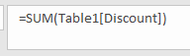
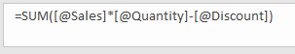
KEY MATRICS AND DATA ANALYZING
Total Revenue :
=SUM(Adjusted Sales)
Average Sales Per Order :
=Average(Adjusted Sales)
Total Discount :
=SUM(Discount)
Other Calculations :
Adjusted Sales :
=SUM(Sales * Quantity – Discount)

Slide 5
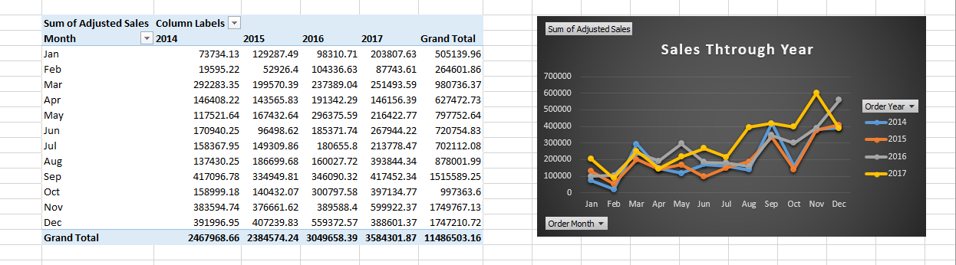
Pivot Tables and Pivot Charts
PIVOT TABLE OVERVIEW :
Sales By Category
Sales By Shipmode
Sales Trend By Order Date
Pivot Chart Visualization :
To Visualize The Sales Trend BY Order Date By Using An Line Chart

Slide 6
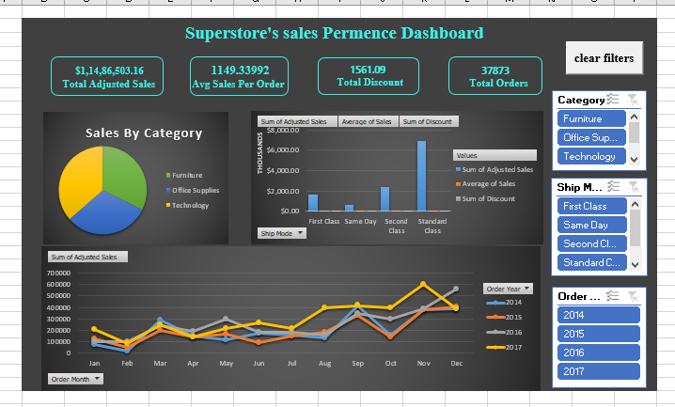
Dashboard Overview
Dash Board Design :
To Analyze an Sales Through Category , Ship Mode , Sales Over Time Is Calculated Through,
KPI’s,
PIVOT CHARTS,
FILTERS.
KPI’s :
Total Adjusted Sales
Total Orders
Total Discounts
Average Sales Value

Slide 7
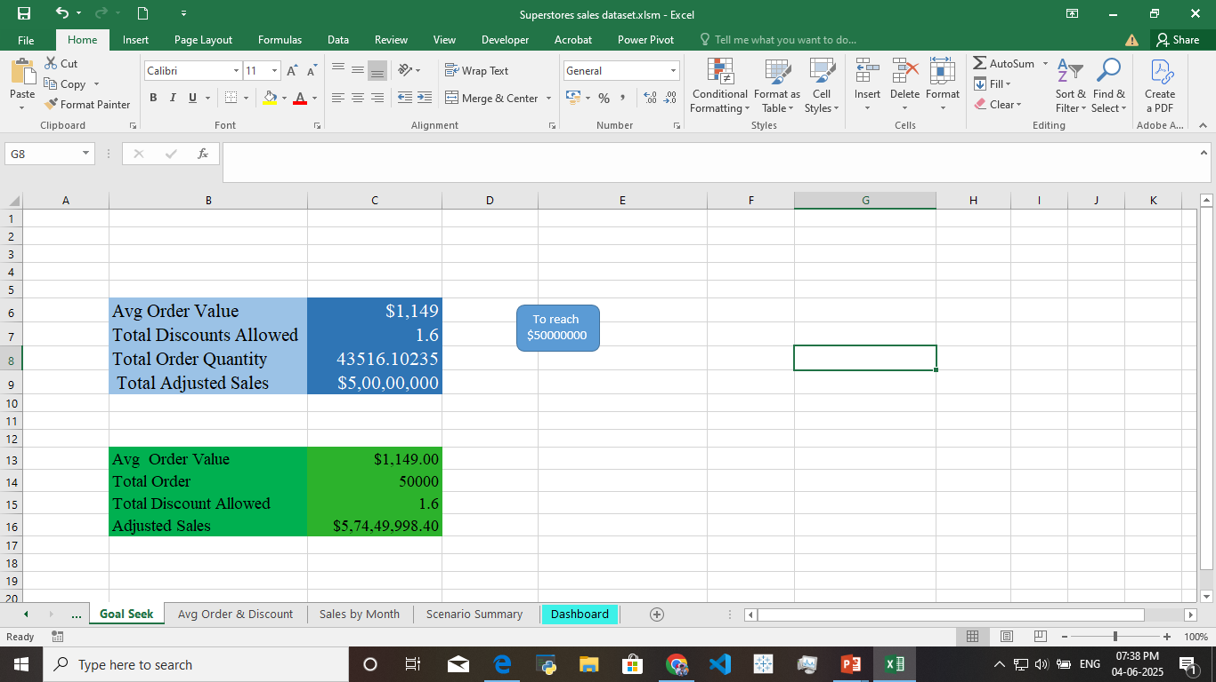
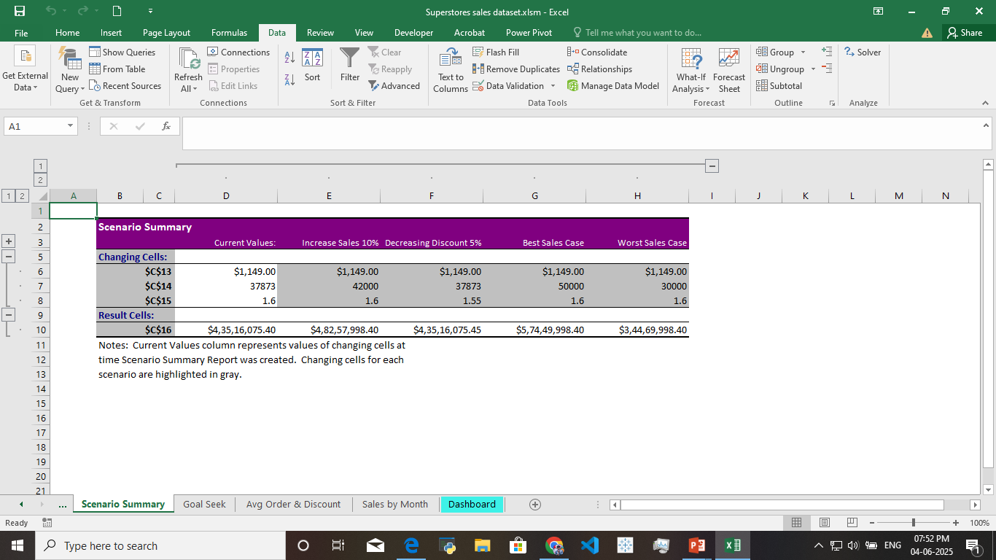
What-If Analysis & Goal Seek
What-If Analysis Scenario’s:
The Scenarios Shows To ,
Increasing The Order By 10%
Decreasing Discount By 5%
Goal Seek :
To Achieve The Total Sales $5,000,00,000 By Increasing Order Quantity.

Slide 8
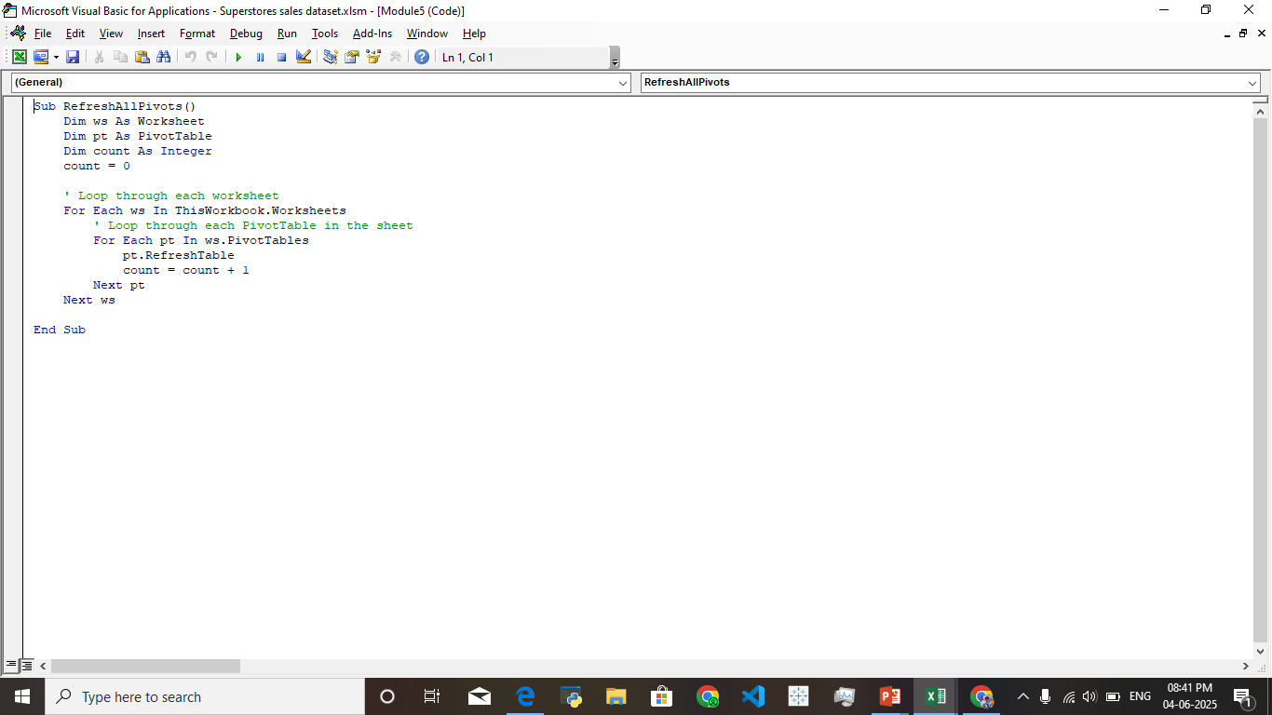
Macros and Automation
Macro Recording :
The Usage an Macro’s I Used to Format the Tables, Creating Pivot Tables ,
Clear Filters and Refreshing the Datasets.
Automation Beniifits :
Formatting Table
Clearing Filters
Pivot Creation
Refreshing Dataset.

Slide 9
Insights and Recommendations
Key Insights :
The Technology Category Has High Sales Then Other Categories
The Sales Is Peaked At The Fourth Quarter(Oct-Dec)
The Standard Ship Category Carries More Sales Then Other’s
The High Volume Sales Has Less Profit Possibilities
Recommendations :
The Technology Category Blooming One , So We Provide an extra Discounts For High Value Purchases
The Fourth Quarter (Oct-Dec) Is An High Sales During That Time , So Stock Up The Inventory Always Full
In Ship Mode We Must Provide An Same Day Delivery To The Customers Is Chance Of Increasing Sales
The Low Profit On High Volume Sales , So we Provide Less Discount For Them

Slide 10
Conclusion and Questions
Summary :
I Using The Sales Analysis Through The Excel And It’s Functions Like Pivot Tables , Pivot Charts , Power Query and Power Pivot.
The Identifying Key Performing Sales Category , Sales Through The Ship Mode , And Sales Trend Over The Years
Creating Power Pivot And Power Pivot Based Dashboard Is More Effective To Deeper Analysis
Creating Macro’s To Automating The Data Set To Repeat Functions Are Done In No Time
Next Steps:
The Forecast Future Sales Prediction Using Excel Based Prediction Tools
Enhancing The Data Accuracy To Perform On The Real Time Validations
For Consider High Performing Sales Category To Predict Upcoming Years And Plan For An Investments
Thank You !

Slide 11
Any Questions ?

